Slide 1
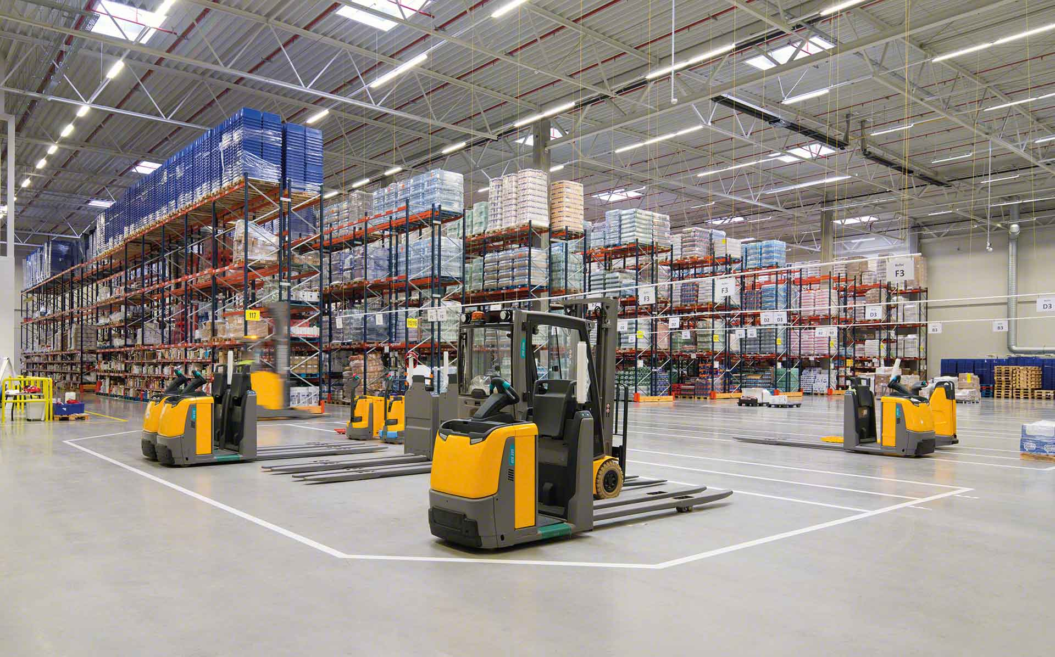

Material Handling KPI
November 2022

Slide 2
Material Handling moves
Row Labels | Sum of CYCLE COUNTS | Sum of MAT HANDLE | Sum of TOTAL
erojas | 1 | 345 | 346
amiranda | 3 | 320 | 323
jtobias | 6 | 254 | 260
judelato | 0 | 237 | 237
jodelacr | 2 | 163 | 165
Grand Total | 12 | 1319 | 1331
Total movements
1331

Slide 3
Adjustments
Adjustments difference
$2792.66
Row Labels | Sum of COST | Count of PART
amiranda | 111.29 | 3
erojas | 2086.9 | 1
jodelacr | -46.65 | 2
jtobias | 641.12 | 5
Grand Total | 2792.66 | 11

Slide 4
Labor intensive
Class not slotted count
11
Labor Intensive
16

Slide 5
restock
Row Labels | Count of Part Number
dic
01-dic | 50
02-dic | 44
05-dic | 79
06-dic | 64
07-dic | 41
08-dic | 60
09-dic | 61
Grand Total | 399
Part Numbers stocked
399

Slide 6
Empty locations
Row Labels | Sum of Total de espacios disponibles
Jul | 316
Aug | 1586
Sep | 623
Oct | 3070
Nov | 1908
Grand Total | 7503
Actual empty locations
307

Slide 7
Discrepancies
Date | Sum of Locaciones
sep | 78
02-sep | 25
05-sep | 15
16-sep | 15
23-sep | 10
30-sep | 13
oct | 27
07-oct | 5
14-oct | 0
28-oct | 9
31-oct | 13
nov | 35
02-nov | 12
04-nov | 5
08-nov | 2
11-nov | 4
14-nov | 4
17-nov | 3
22-nov | 5
25-nov | 0
Grand Total | 140
Total discrepancies
0

Slide 8
Consolidation
Row Labels | Sum of count of consolidations
14/08/2022 | 27
28/09/2022 | 24
06/10/2022 | 35
13/10/2022 | 26
20/10/2022 | 20
27/10/2022 | 29
17/11/2022 | 18
24/11/2022 | 15
Grand Total | 194
Total Consolidations
194

